Slide 1
Credit Card Lead Prediction
Binary Classification Project to predict if an account is a lead for Credit Card
Dataset Source – Analytics Vidhya – Job-a-thon

Slide 2
Dataset
The Dataset is divided into two sub sets – Train and Test Data
Train Dataset has 2,45,725 entries and 11 columns
Test Dataset has 1,05,312 entries and 10 columns.
Variable | Definition
ID | Unique Identifier for a row
Gender | Gender of the Customer
Age | Age of the Customer (in Years)
Region_Code | Code of the Region for the customers
Occupation | Occupation Type for the customer
Channel_Code | Acquisition Channel Code for the Customer (Encoded)
Vintage | Vintage for the Customer (In Months)
Credit_Product | If the Customer has any active credit product (Home loan, Personal loan, Credit Card etc.)
Avg_Account_Balance | Average Account Balance for the Customer in last 12 Months
Is_Active | If the Customer is Active in last 3 Months
Is_Lead(Target) | If the Customer is interested for the Credit Card 0 : Customer is not interested 1 : Customer is interested

Slide 3
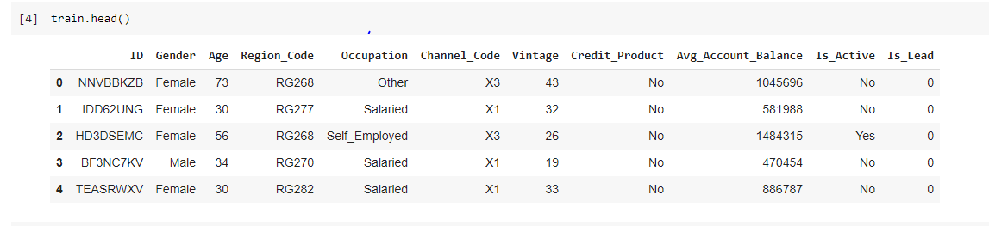
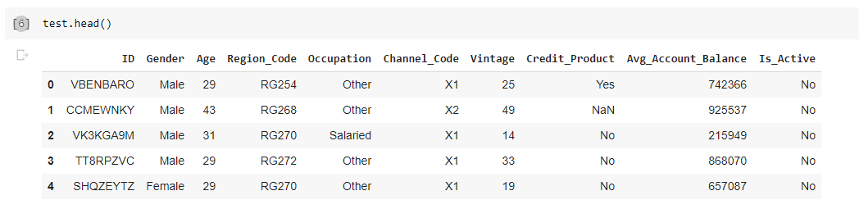
Dataset (Contd...)

Slide 4
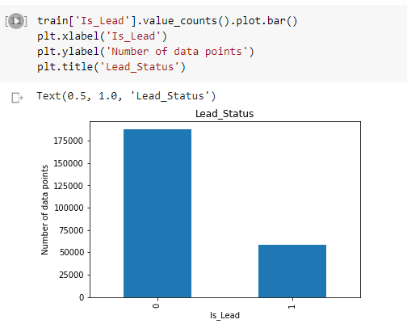
Target Variable Analysis
On analyzing the Target variable, it was observed that the data is highly imbalanced.
Approximately 76% of the data is not a Lead and only 24% data is lead
This means, we cannot assume “Accuracy” as a correct measure of our model.

Slide 5
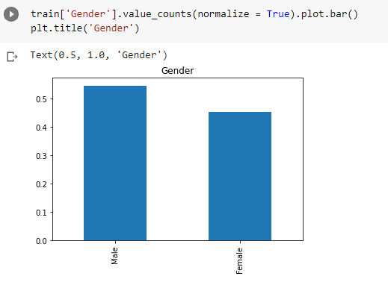
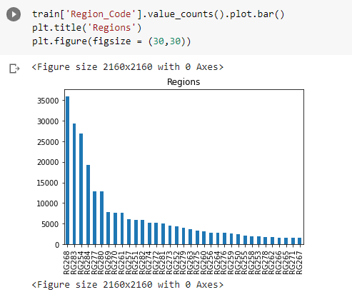
Univariate Analysis
Gender
Region_Code
The data is almost equally distributed among genders. Number of Males are slightly higher, but that depicts the general population distribution of the country as well
Majority of the data is available from regions RG268, RG283, RG254. This could be because these regions have higher customer base. It can be assumed that these regions lie in metro cities. But any specific trend in these regions will highly impact our model

Slide 6
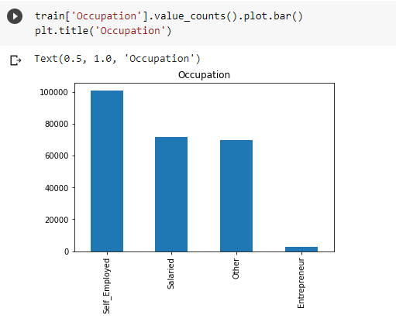
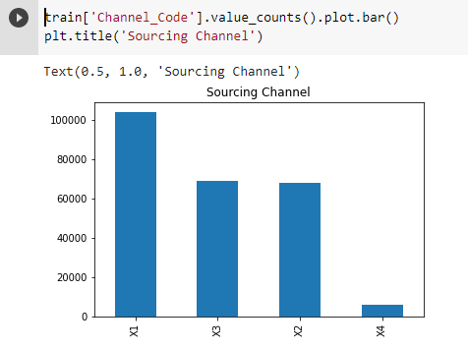
Univariate Analysis (Contd…)
Occupation
Channel_Code
There are very few Entrepreneurs in the data. They can be clubbed with 'Other' to make our data clean. Further analysis is required before clubbing them. (Refer Slide 11)
X4-channel sourced customers are very few in the dataset. Since this is an encoded column, we can't predict much about it.

Slide 7
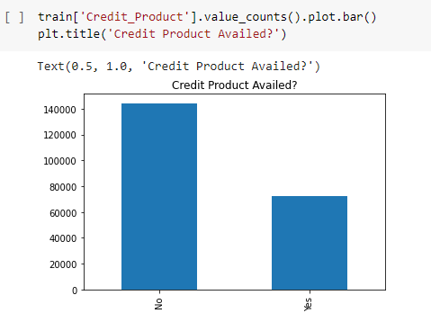
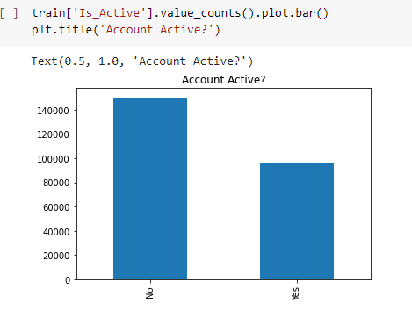
Univariate Analysis (Contd…)
Credit_Product
Is_Active
Relatively higher number of customers are not availing any credit product
A higher number of customers are not active in last 3 months. This could be linked to high number of Jandhan accounts opened and not operated since

Slide 8
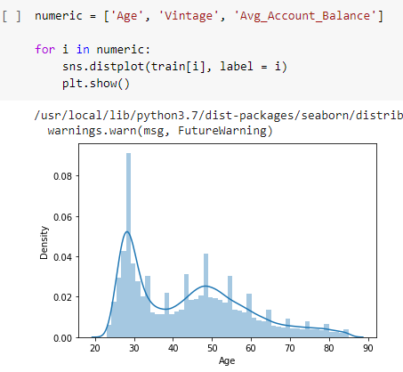
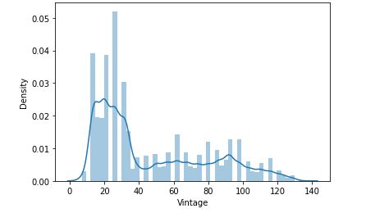
Univariate Analysis (Contd…)
Age
Vintage
The curve is flat and right skewed
Curve of Age is multimodal with right skewness

Slide 9
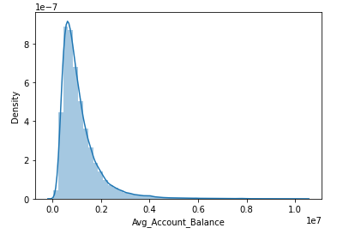
Univariate Analysis (Contd…)
Avg_Account_Balance
The curve is right skewed

Slide 10
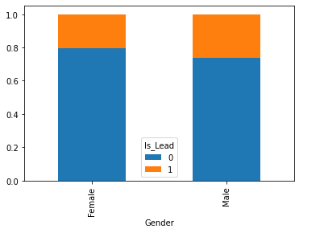
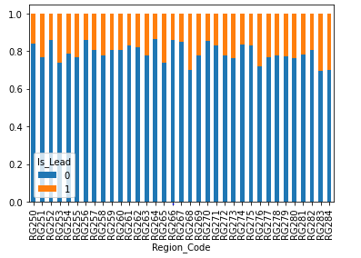
Bivariate Analysis
Gender Vs Is_Lead
Region_Code Vs Is_Lead
Lead does not depend on Gender
Ratio of Leads is almost same for all Regions, ranging from 0.15 to 0.30

Slide 11
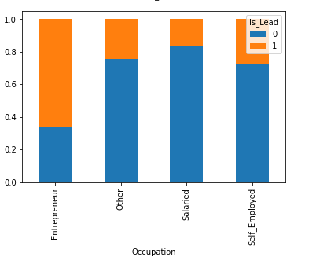
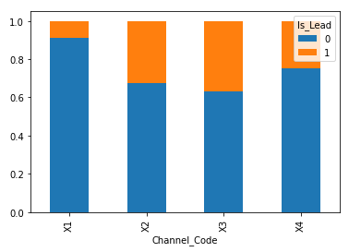
Bivariate Analysis (Contd…)
Occupation Vs Is_Lead
Channel_Code Vs Is_Lead
Chances of having leads among entrepreneurs is high compared to other occupations. We had earlier planned to merge Entrepreneurs with others because of their small presence in the data. However, this revelation shows the importance of Entrepeneurs and is required separately in the dataset
Leads are particularly low for X1 Channel. Since this is an encoded column, we can't predict much about it

Slide 12
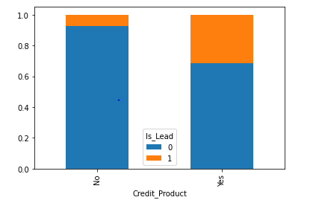
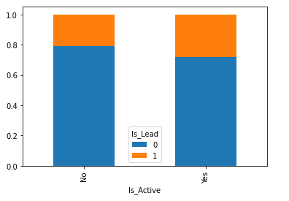
Bivariate Analysis (Contd…)
Credit_Product Vs Is_Lead
Is_Active Vs Is_Lead
Chances of having a lead are more with people availing a Credit Product. This was already expected, because customers availing a Credit Product are expected to have a better financial condition and social status and would thus require Credit Card.

Slide 13
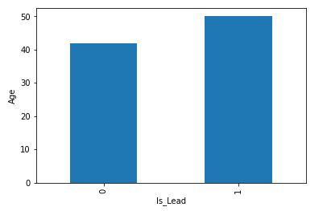
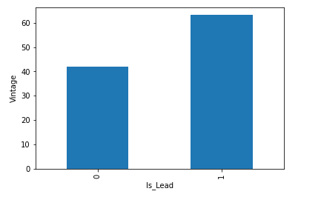
Bivariate Analysis (Contd…)
Age Vs Is_Lead
Vintage Vs Is_Lead
Customer having higher vintage is more likely to be a lead
A higher aged person is more likely to be a lead for Credit Card

Slide 14
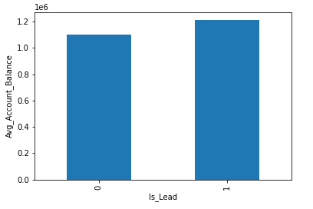
Bivariate Analysis (Contd…)
Avg_Account_Balance Vs Is_Lead
Average Account balance is not a big game changer.

Slide 15
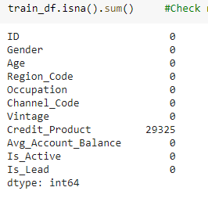
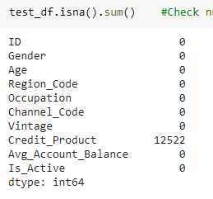
Treating NaN values
Credit_Product Column has NaN values
Train dataset has 29,325 NaN values in Credit_Product column
Test dataset has 12,522 NaN values in Credit_Product column

Slide 16
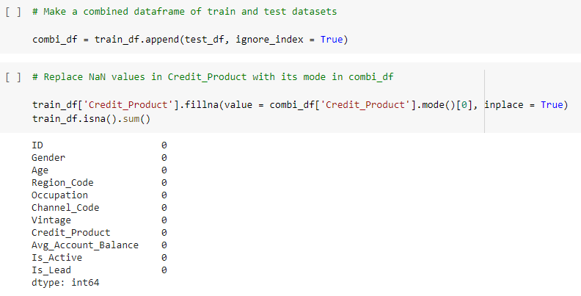
Treating NaN values (Contd…)
We can either delete the rows having NaN values or replace the NaN values with a suitable figure
On deleting NaN values, it was observed that the ratio of “Is_Lead” further widened.
Hence we replace NaN values with mode of the column

Slide 17
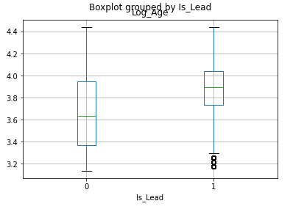
Normalization – “Age”
Log normalization was applied to “Age” column
Log Normalization heavily penalizes higher numbers and does not have much impact on small numbers
After normalization few outliers were present:
These outliers were deleted
All steps were simultaneously performed on test dataset

Slide 18
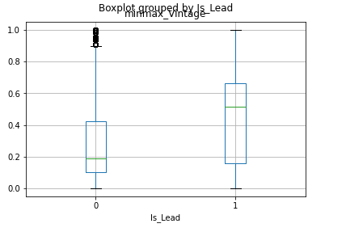
Normalization – “Vintage”
MinMax normalization was applied to “Vintage” column
MinMax Normalization reduces the values to the range 0 to 1
After normalization few outliers were present:
These outliers were deleted
All steps were simultaneously performed on test dataset

Slide 19
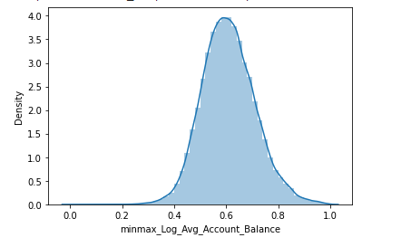
Normalization – “Avg_Account_Balance”
Log normalization was applied to “Avg_Account_Balance” column
Because of high numeric values, log function reduced the values to the range 10 to 16
MinMax Normalization was applied to the normalized data for further reducing the range to 0 to 1
After Normalization, a smooth normal curve was obtained

Slide 20
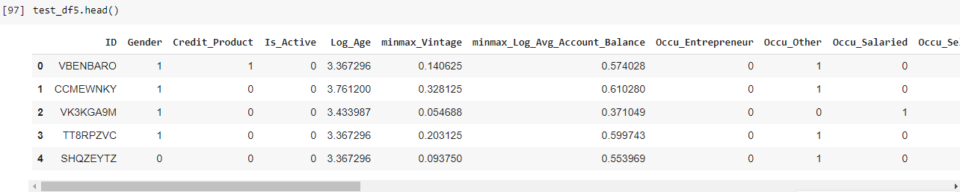
Categorical Data to Numeric Data
Categorical Data was converted to numeric Data using the following schemes:
Gender : Female = 0, Male = 1
Credit_Product : No = 0, Yes = 1
Is_Active : No = 0, Yes = 1
Occupation : one hot encoding
Channel_Code : one hot encoding
Region_Code : one hot encoding
For model training, column “ID” doesn’t play any role. Hence the same is dropped from the dataset

Slide 21
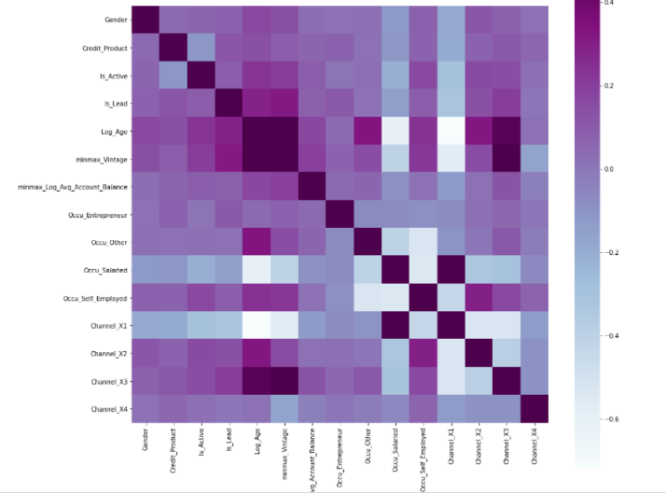
Multicollinearity Detection & Treatment
The Heat map shows high collinearity between the following Independent variables:
Age & Vintage
Age & Channel_X3
Vintage & Channel_X3
Occu_Salaried & Channel X1

Slide 22
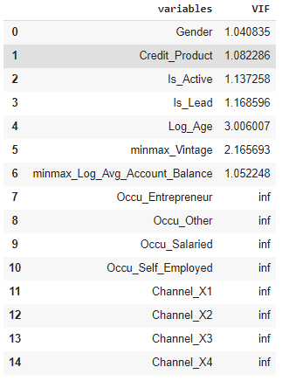
Multicollinearity Detection & Treatment
On checking Variable Inflation Factor (VIF), the following was observed:
VIF of Age and Vintage is high
VIF of Occupation and Channel fields is “infinite”

Slide 23
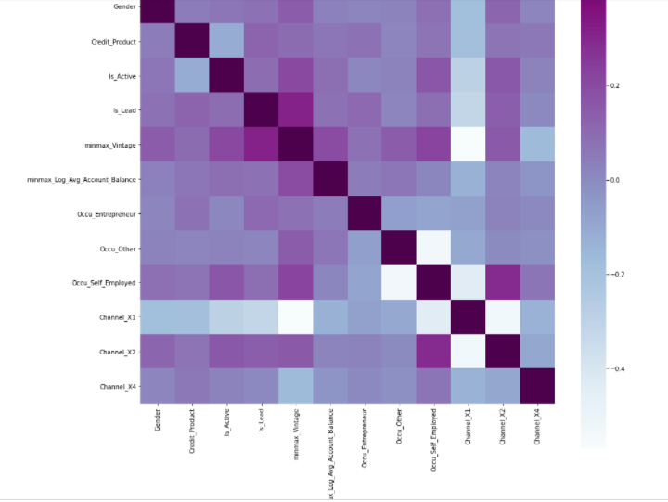
Multicollinearity Detection & Treatment
We deleted columns “Age”, “Occu_Salaried” and “Channel_X3”.
Multicollinearity reduced considerably

Slide 24
MACHINE LEARNING

Slide 25
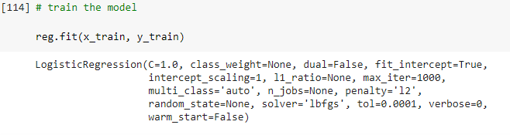

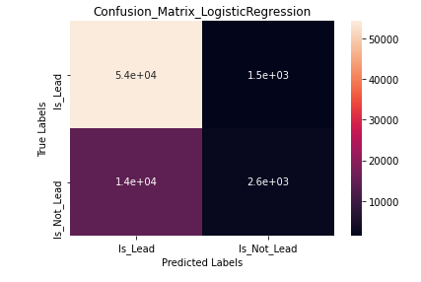
LOGISTIC REGRESSION
Hyperparameters
ROC AUC Score
Confusion Matrix

Slide 26
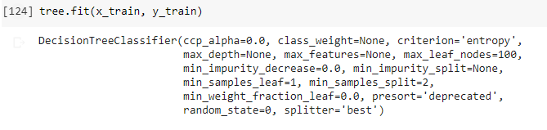

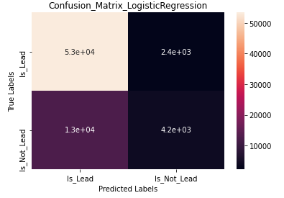
DECISION TREE
Hyperparameters
ROC AUC Score
Confusion Matrix

Slide 27
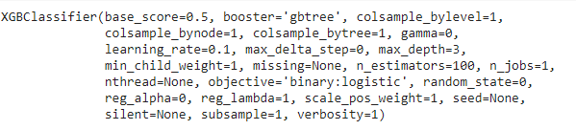

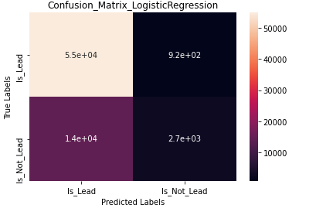
XGBoost
Hyperparameters
ROC AUC Score
Confusion Matrix

Slide 28
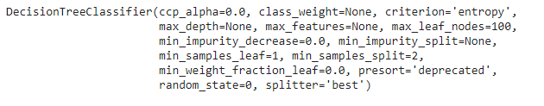

SMOTE + Decision Tree
Hyperparameters
ROC AUC Score

Slide 29
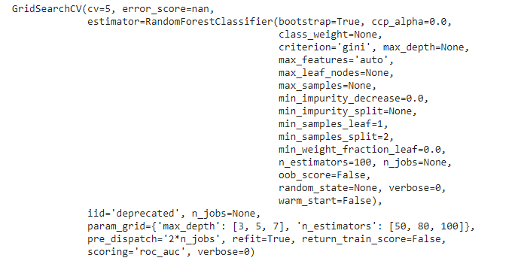

SMOTE + Random Forest
Hyperparameters
ROC AUC Score

Slide 30
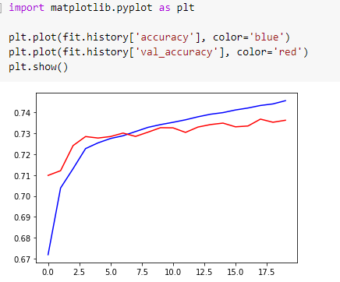

SMOTE + Deep Neural network
Accuracy check
ROC AUC Score

Slide 31
THANK YOU

